Slide 1
DISEASECARD
AGGREGATION AND VISUALIZATION OF RARE GENETIC DISEASES DATA
M4 - Final Presentation
Projeto em Informática
2023-2024

Slide 2

01
OUR TEAM

Slide 3
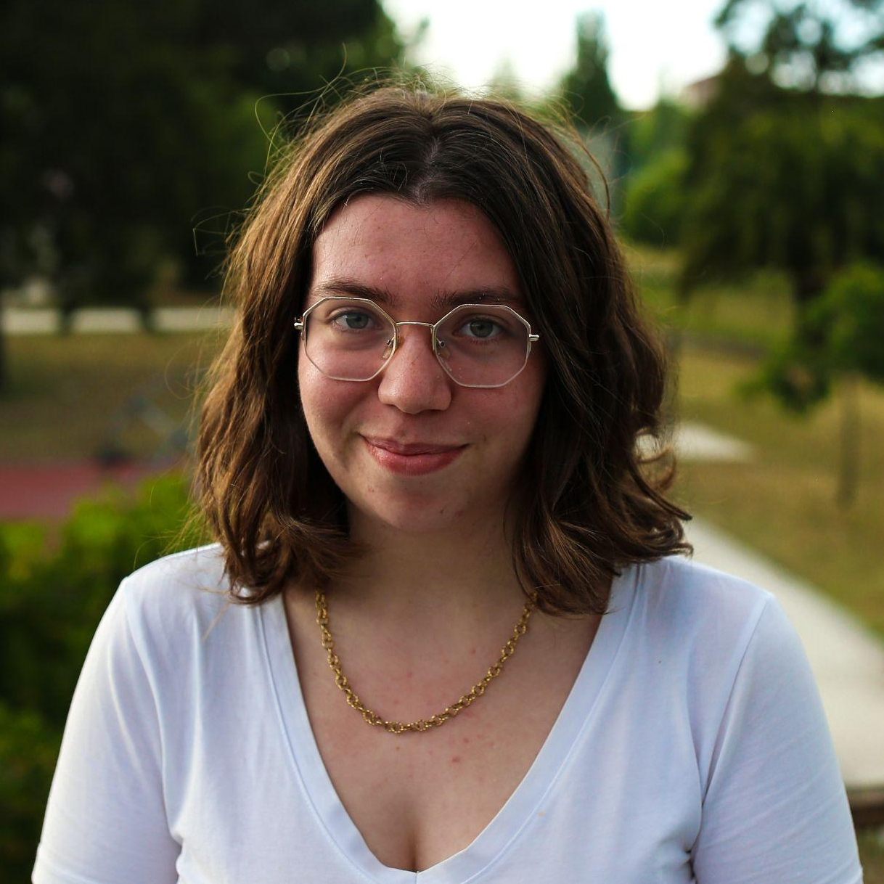
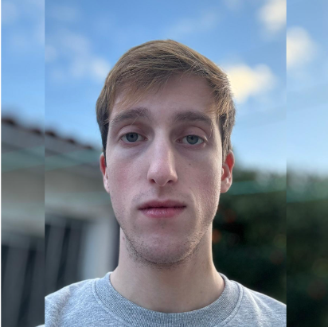
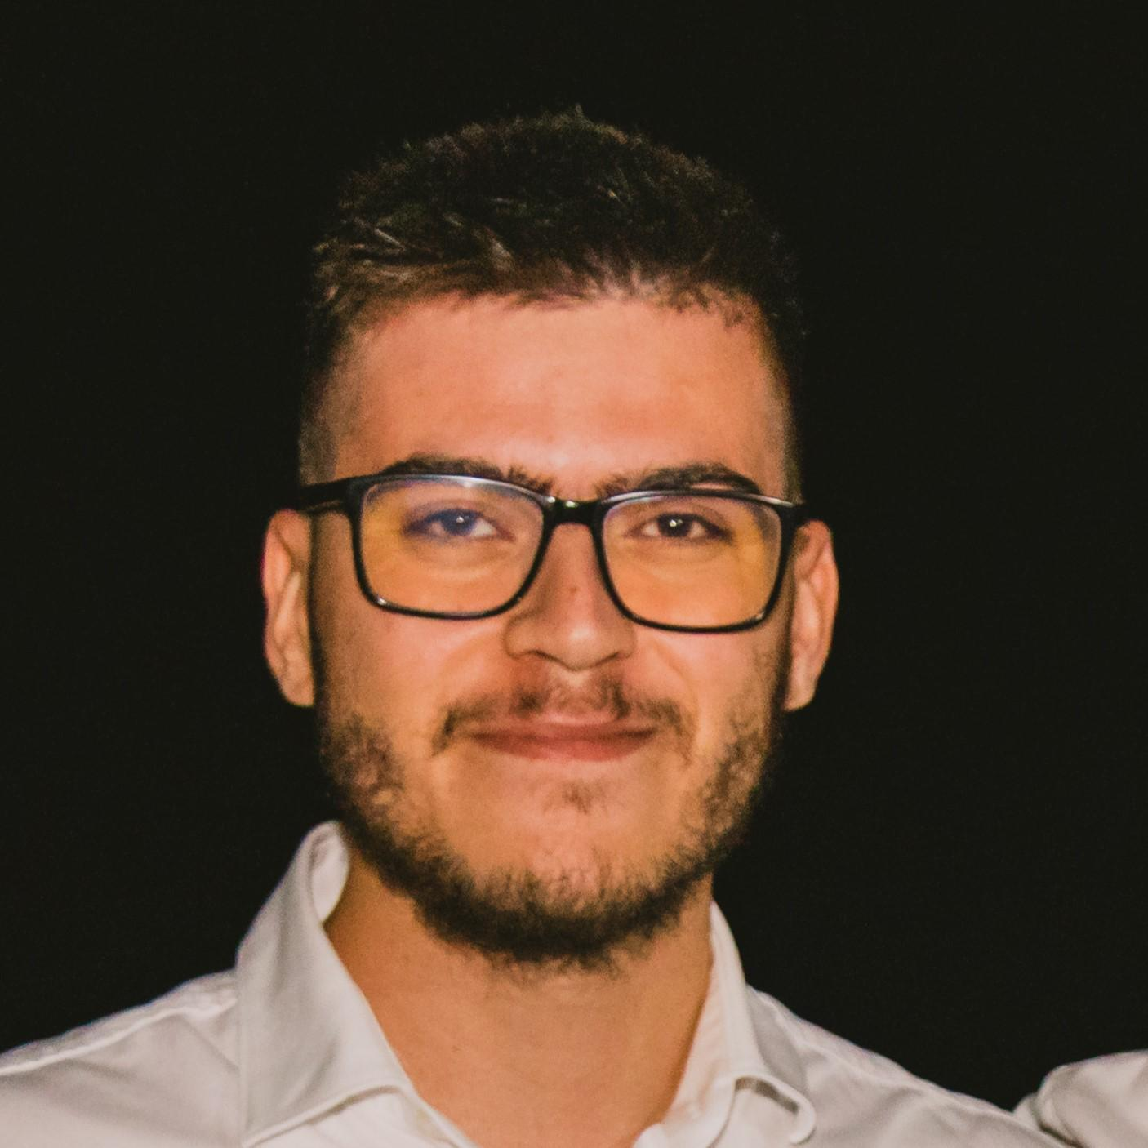
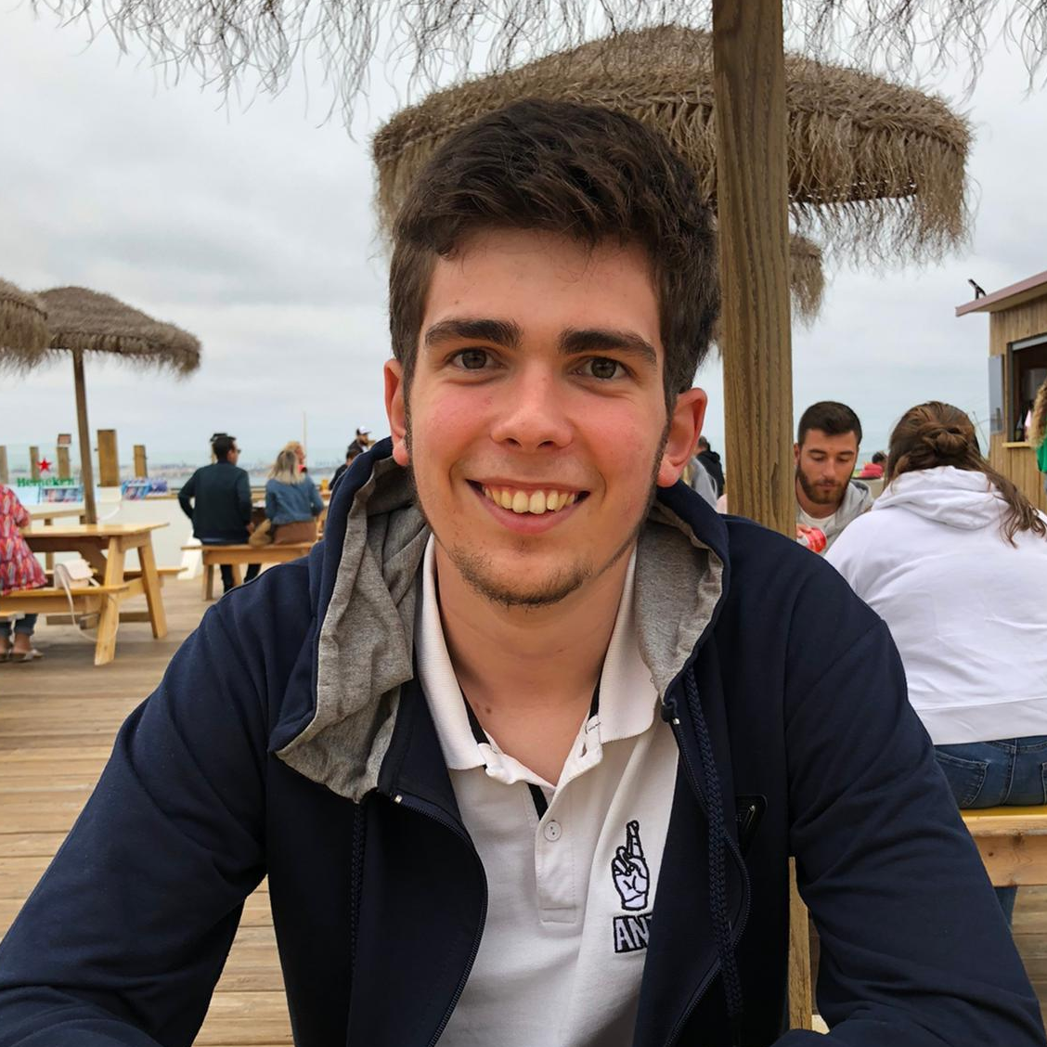
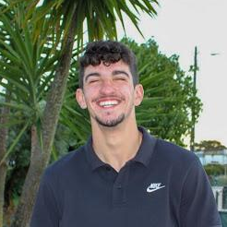
OUR TEAM
MATILDE TEIXEIRA
ALEXANDRE RIBEIRO
RAFAEL FERREIRA
GUILHERME AMORIM
RODRIGO GRAÇA
Project Manager
DevOps
Architect
Product Owner
Mobile Dev

Slide 4
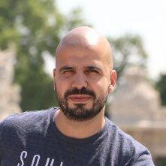
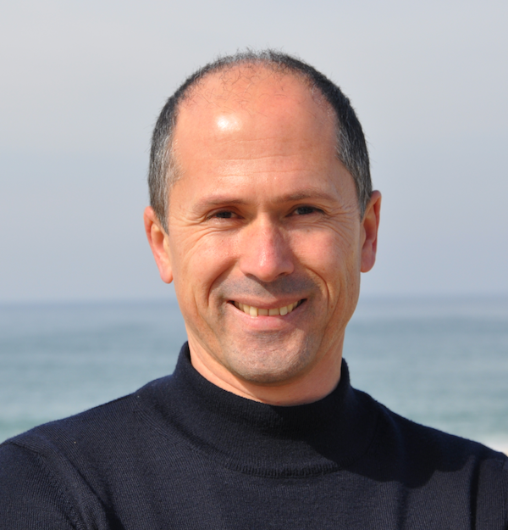
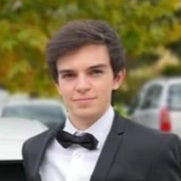
GUIDING TEACHERS
JOÃO ALMEIDA
JOSÉ OLIVEIRA
TIAGO ALMEIDA

Slide 5

02
CONTEXT

Slide 6
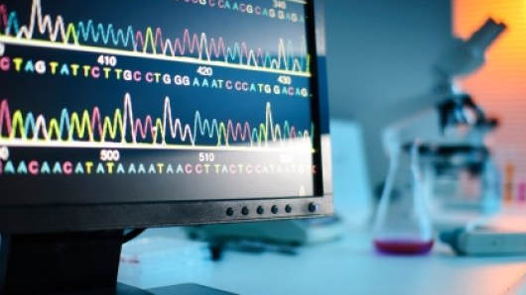


CONTEXT
Healthcare and medical research constantly require new applications and technologies
There is a growing availability of medical data

Slide 7

03
PROBLEMS

Slide 8
Lack of Usability
Difficult to understand the information, even for the medic professional
Current System not Updated
With the evolution of data sources it is hard to update the current automatically.
Data non-Normalized
The data has not gone through data quality processes such as data cleansing and deduplication so it is not organized in a proper way.

Slide 9

04
STATE OF ART

Slide 10
STATE OF THE ART
More info here
Features |  | Orphanet | Malacards | Disease Ontology | GARD | NCBI | UptoDate | DiseaseCard | Our DiseaseCard
Functional | Mobile App | ✅ | ❌ | ❌ | ❌ | ❌ | ❌ | ❌ | ✅
 | Search | ✅ | ✅ | 📈 | ✅ | ✅ | ✅ | ✅ | ✅
 | Advanced Search | ✅ | 📈 | ✅ | ❌ | ❌ | ❌ | ❌ | ✅
 | Auto-complete | 📈 | 📈 | ❌ | ✅ | ✅ | ✅ | 📈 | ✅
 | Disease Categories | ✅ | ✅ | ✅ | ✅ | ❌ | ✅ | ❌ | ✅
 | Related Diseases | ❌ | ✅ | ✅ | ❌ | ❌ | ✅ | ❌ | ✅
Description:
✅ - totally implemented
📈 - need improvements
❌ - not implemented

Slide 11
05
GOALS

Slide 12
GOALS
Data Collection and Integration
Activity Monitoring
Protected Backoffice
Web Interface for Search

Slide 13
06
REQUIREMENTS

Slide 14
REQUIREMENTS GATHERING
Brainstorming amongst the team
Gathering information from related websites
Interviewing medicine students
Studying previous work

Slide 15
FUNCTIONAL REQUIREMENTS
Disease Information
Updatable
Flexible and Accessible Search
Secure Authentication (Admin)
Manage Endpoints (Admin)
CRUD Methods (Admin)

Slide 16
NON-FUNCTIONAL REQUIREMENTS
Modular Architecture
Accessibility
High Performance
Scalability

Slide 17
07
USAGE OF THE SYSTEM

Slide 18


ACTORS
User
Admin

Slide 19
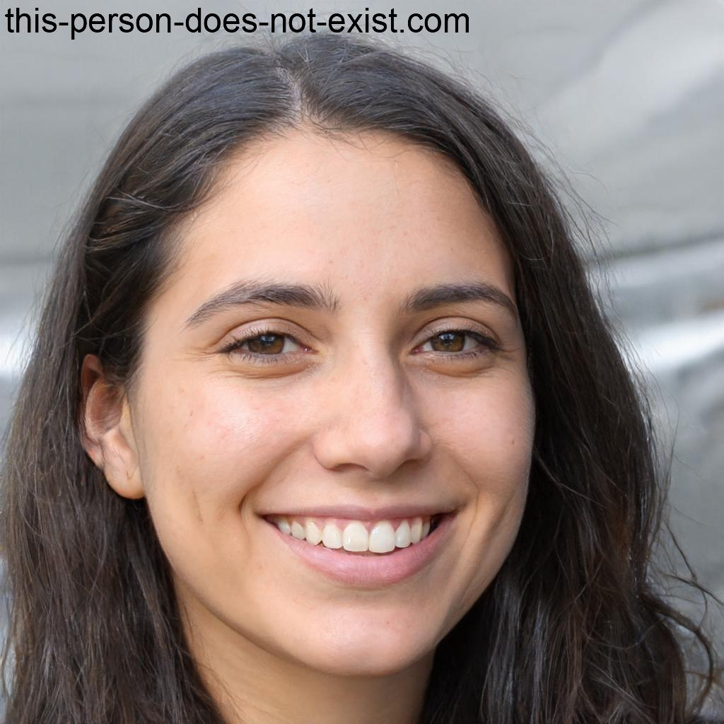
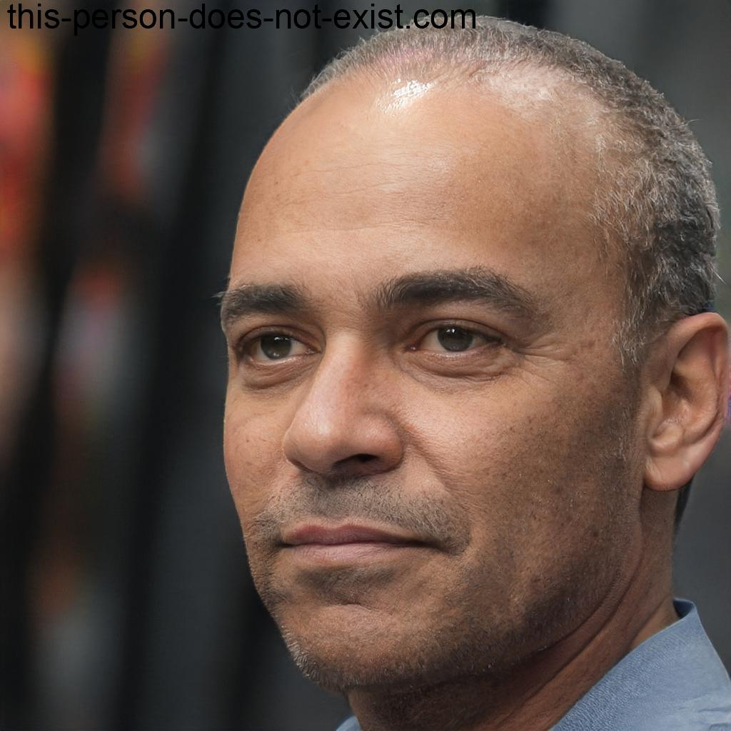
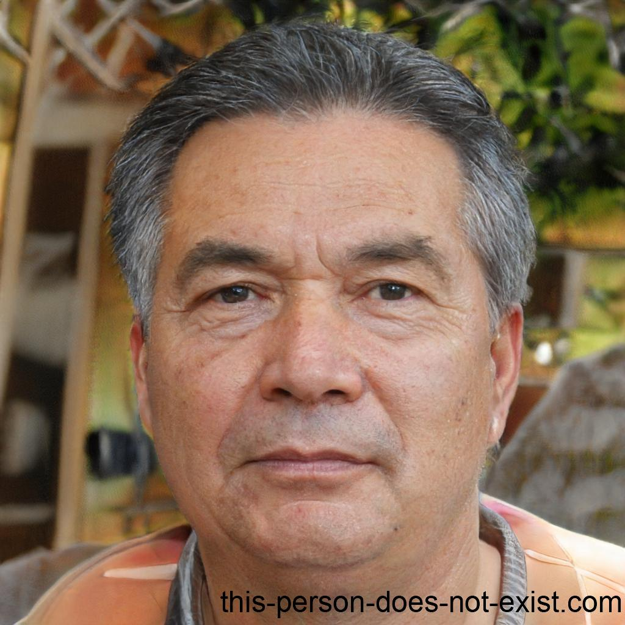
PERSONAS
Emily Watson, 23y
Medicine Student
Wants to use Diseasecard because of her research work about Diabetes, so pretends to read a lot of articles about the many types of Diabetes.
Charles Sterling, 46y
Master Degree in Informatics Engineer
The Head of Diseasecard. Pretends to add George Stevens, the new medical admin, to the system
George Stevens, 67y
Retired medic
Was offered a part-time position to manage Diseasecard data related to diseases

Slide 20
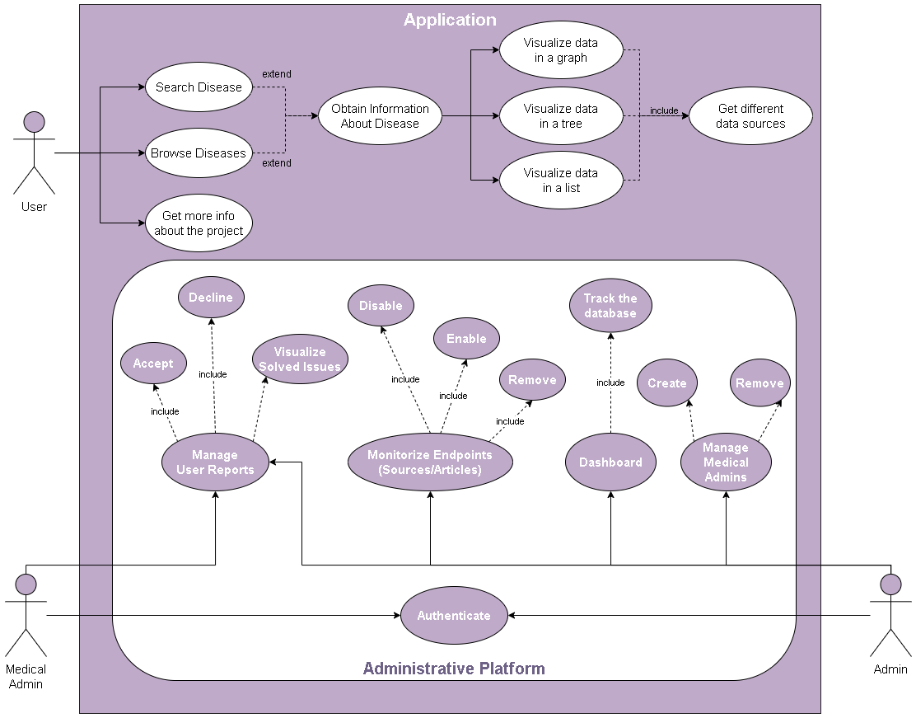

Slide 21
08
RBAC

Slide 22


ADMIN:
Can Access:
MEDICAL ADMIN:
Can Access:
Number of Diseases, Disease Family, Sources, Articles
Disable/Enable/Remove Article or Source
See Feedback and Approve it
See Feedback and Approve it

Slide 23
09
ARCHITECTURE

Slide 24
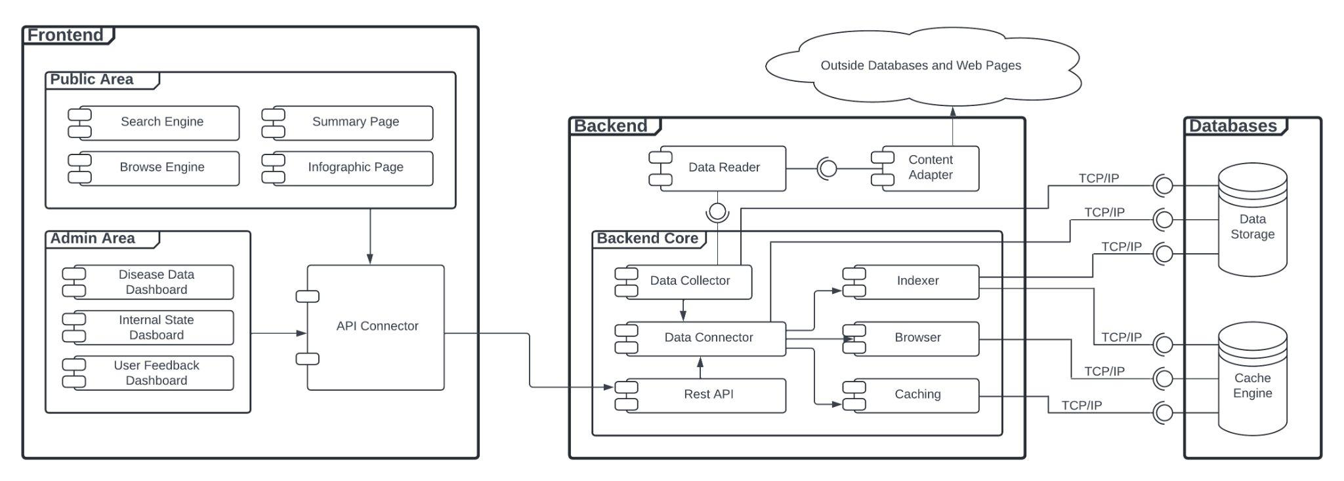
ARCHITECTURE
Enterprise Architecture

Slide 25
10
DOMAIN MODEL

Slide 26
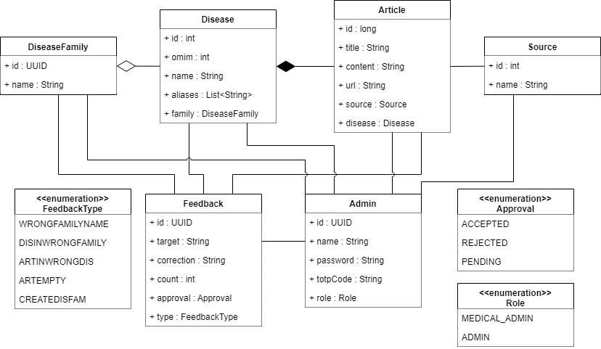
DOMAIN MODEL

Slide 27
11
WEB
SCRAPING

Slide 28
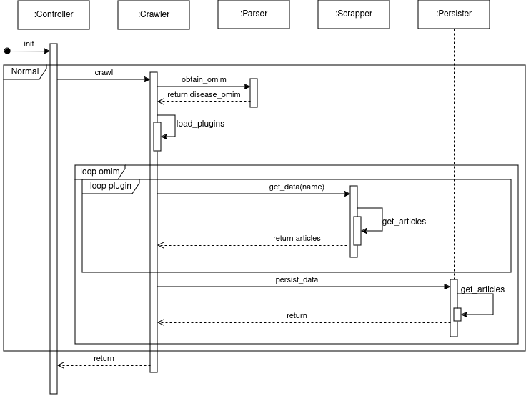
Web Scraping Process
"name": "mock",
"url": "https://www.mock.com/",
"search_query": "search/results?q=",
"search_info": {
"orpha_id": {
"scope": "single",
"html_tag": "span",
"id_": null,
"class_": “fw-bold"
}
},
"article_query": "/detail/",
"article_info": {
"abstract": {
"scope": "single",
"html_tag": "div",
"id_": null,
"class_": "mx-4 mb-4 p-4"
}
}

Slide 29
12
AGGREGATION
ALGORITHM

Slide 30
AGGREGATION ALGORITHM
Multiple Sclerosis, Susceptibility To; MS
MS
Multiple Sclerosis, Susceptibility To;
Multiple Sclerosis, Susceptibility to, 2; MS2
Multiple Sclerosis, Susceptibility to, 3; MS3
Multiple Sclerosis, Susceptibility to, 4; MS4
Multiple Sclerosis
{MS, MS2, MS3, MS4, MS5}
Multiple Sclerosis, Susceptibility to, 5; MS5

Slide 31
13
DEPLOYMENT
DIAGRAM

Slide 32
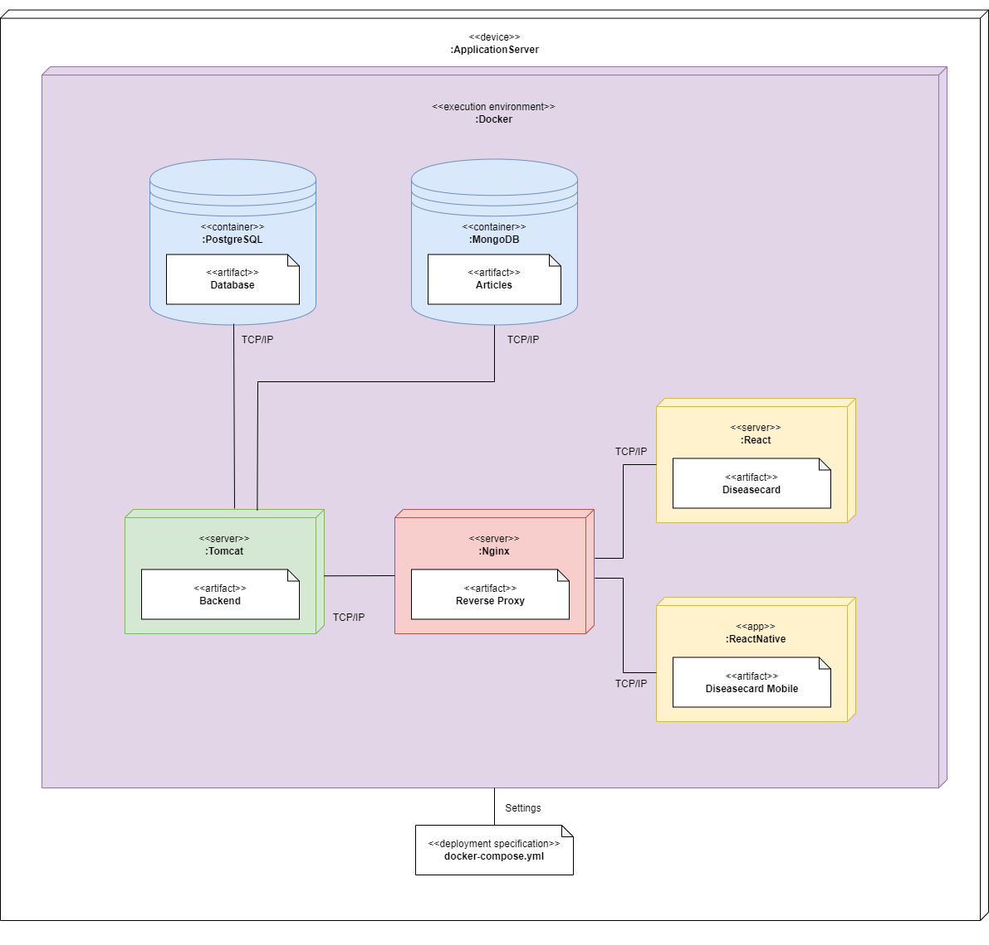
DEPLOYMENT DIAGRAM

Slide 33
14
RESULTS

Slide 34
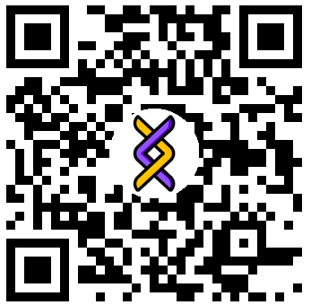

Linktree
Download here
OUR Android APP!

Slide 35
15
FUTURE WORKS

Slide 36
FUTURE WORKS
ChatBot
2FA
iOS Support
More Sources

Slide 37
Thanks!
You can visit our Microsite, Website and Install our app here!
SCAN ME
Alexandre Ribeiro, 108122
Guilherme Amorim, 107162
Matilde Teixeira, 108193
Rafael Ferreira, 107340
Rodrigo Graça, 107634
‹#›

